Slide 1
Monolithic Apps

Slide 2

Monolithic App

Slide 3
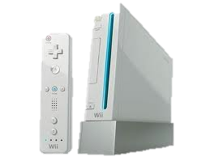



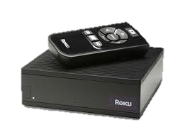




Monolithic Architecture
Load Balancer
Monolithic App
Account Component
Catalog
Component
Database
Recommendation
Component
Customer Service
Component

Slide 4
Characteristics
Large Codebase
Many Components, no clear ownership
Long deployment cycles

Slide 5
Pros
Single codebase
Easy to develop/debug/deploy
Good IDE support
Easy to scale horizontally (but can only scale in an “un-differentiated” manner)
A Central Ops team can efficiently handle

Slide 6

Monolithic App – Evolution
As codebase increases …
Tends to increase “tight coupling” between components
Just like the cars of a train
All components have to be coded in the same language

Slide 7


Slide 8

Evolution of a Monolithic App
Shopping Cart
User Accounts
Product Catalog
Customer Service

Slide 9

Monolithic App - Scaling
Scaling is “undifferentiated”
Cant scale “Product Catalog” differently from “Customer Service”

Slide 10
Availability

Slide 11
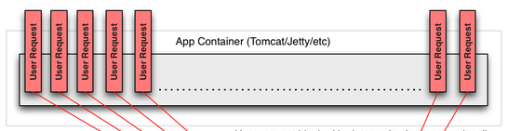

Availability
A single missing “;” brought down the Netflix website for many hours (~2008)

Slide 12
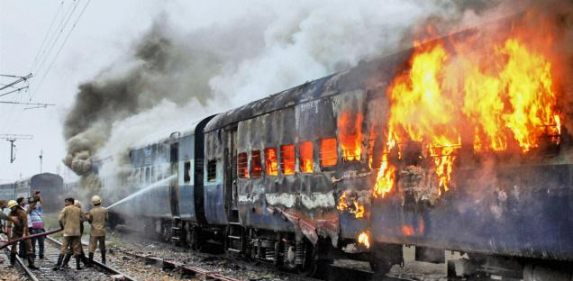
Monolithic Apps – Failure & Availability

Slide 13

MicroServices
You Think??

Slide 14


Tipping Point
&
&
Organizational Growth
Disverse Functionality
Bottleneck in
Monolithic stack

Slide 15
What are MicroServices?

Slide 16

Not about …
Team size
Lines of code
Number of API/EndPoints
MicroService
MegaService

Slide 17

Characteristics
Many smaller (fine grained), clearly scoped services
Single Responsibility Principle
Domain Driven Development
Bounded Context
Independently Managed
Clear ownership for each service
Typically need/adopt the “DevOps” model
Attribution: Adrian Cockroft, Martin Fowler …

Slide 18

Monolithic App (Various Components linked together)
Comparing Monolithic to MicroServices

Slide 19

MicroServices – separate single purpose services

Slide 20
Monolithic Architecture (Revisiting)
Load Balancer
Monolithic App
Account Component
Catalog
Component
Database
Recommendation
Component
Customer Service
Component

Slide 21
Microservices Architecture
Load Balancer
API Gateway
Catalog DB
Account Service
Catalog
Service
Customer DB
Recommendation
Service
Customer Service
Service

Slide 22
Concept -> Service Dependency Graph
Service X
Service L
Your App/Service
Service Y
Service M
Service Z

Slide 23
MicroServices - Why?

Slide 24
Why?
Faster and simpler deployments and rollbacks
Independent Speed of Delivery (by different teams)
Right framework/tool/language for each domain
Recommendation component using Python?, Catalog Service in Java ..
Greater Resiliency
Fault Isolation
Better Availability
If architected right ☺

Slide 25
MicroServices - Challenges

Slide 26

Challenges
Can lead to chaos if not designed right …

Slide 27
Overall Complexity
Distributed Systems are inherently Complex
N/W Latency, Fault Tolerance, Retry storms ..
Operational Overhead
TIP: Embrace DevOps Model

Slide 28


Service Discovery
100s of MicroServices
Need a Service Metadata Registry (Discovery Service)
Registry
Service
(e.g. Netflix Eureka)
Account Service
Catalog
Service
Recommendation
Service
Customer Service
Service
X
Service
Y
Service
Z
Service

Slide 29
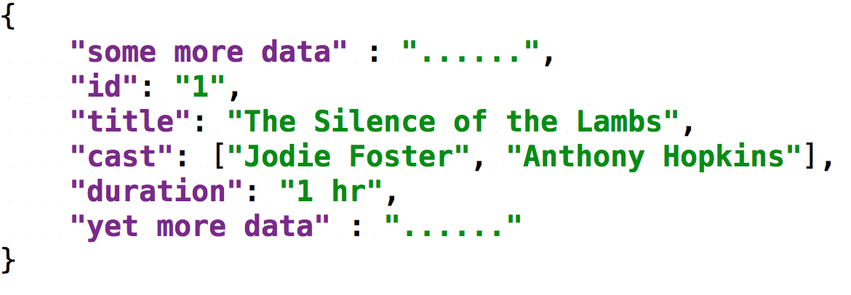
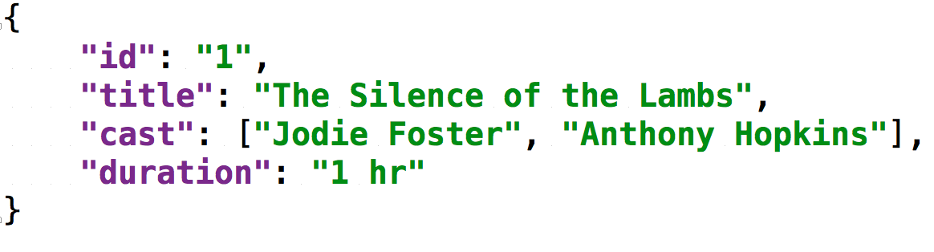
Data Serialization Overhead
Data transformation
getMovies()
getMovie()
getMovieMetadata()
Service A
Service B
Service C
Service D
Cl
ient
B
Cl
ient
C
Cl
ient
D
X
X
Avro
JSON
Xml

Slide 30
Challenges - Summary
Service Discovery
Operational Overhead (100s of services; DevOps model absolutely required)
Distributed Systems are inherently Complex
N/W Latency, Fault Tolerance, Serialization overhead ..
Service Interface Versioning, Mismatches?
Testing (Need the entire ecosystem to test)
Fan out of Requests -> Increases n/w traffic

Slide 31
Best Practices/Tips

Slide 32
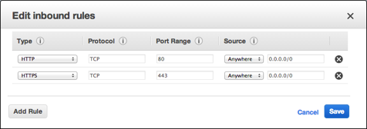
Best Practice -> Isolation/Access
TIP: In AWS, use Security Groups to isolate/restrict access to your MicroServices
http://docs.aws.amazon.com/AWSEC2/latest/UserGuide/using-network-security.html

Slide 33
Best Practice -> Loadbalancers
Choice
Central Loadbalancer? (H/W or S/W)
OR
2. Client based S/W Loadbalancer?

Slide 34
Central (Proxy) Loadbalancer
API Gateway
Customer Service Load Balancer
Account Service Load Balancer
Customer Service
Service 1
Account Service 1
Account Service N
Reco Service
Load Balancer
Customer Service
Service N
Recommendation
Service 1
Recommendation
Service N

Slide 35
Client Loadbalancer
API Gateway
Account Service LB
Recommendation
Service LB
Customer Service
Service LB
Customer Service
Service 1
Account Service 1
Account Service N
Customer Service
Service N
Recommendation
Service 1
Recommendation
Service N

Slide 36
Best Practice -> LoadBalancers
TIP: Use Client Side Smart LoadBalancers

Slide 37
Best Practices contd..
Dependency Calls
Guard your dependency calls
Cache your dependency call results
Consider Batching your dependency calls
Increase throughput via Async/ReactiveX patterns

Slide 38
Availability
MicroServices does not automatically mean better Availability
- Unless you have Fault Tolerant Architecture

Slide 39
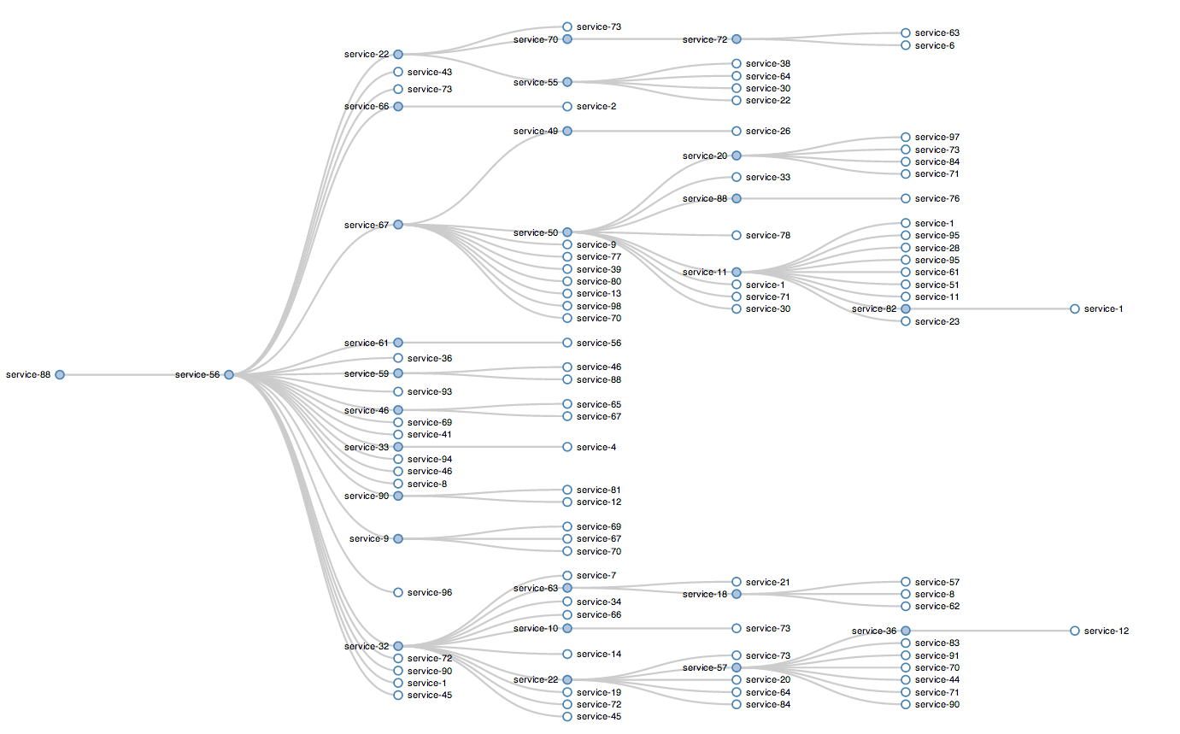
Notes:
Startup dependencies hurt us on scale up event
Degrading without knowing is bad

